Slide 1

ISO & GeoDCAT-AP Pilot Working Team T-1B
Geospatial High-Value Datasets tagging good practice specification
Antonio ROTUNDO (AgID – Italy)
Jordi ESCRIU (JRC – European Commission)

Slide 2
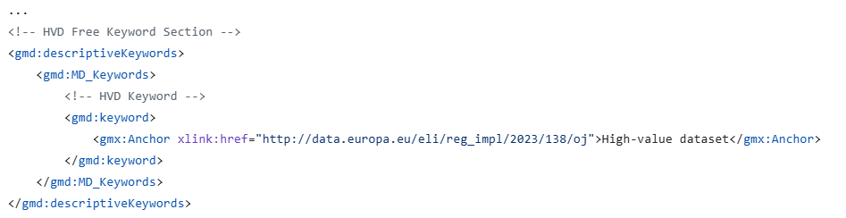

Starting point
Agreed HVD (geospatial) tagging
applicable legislation
DCAT-AP High Value Datasets
1
Example:
Keyword for citing the EU HVD Regulation

Slide 3
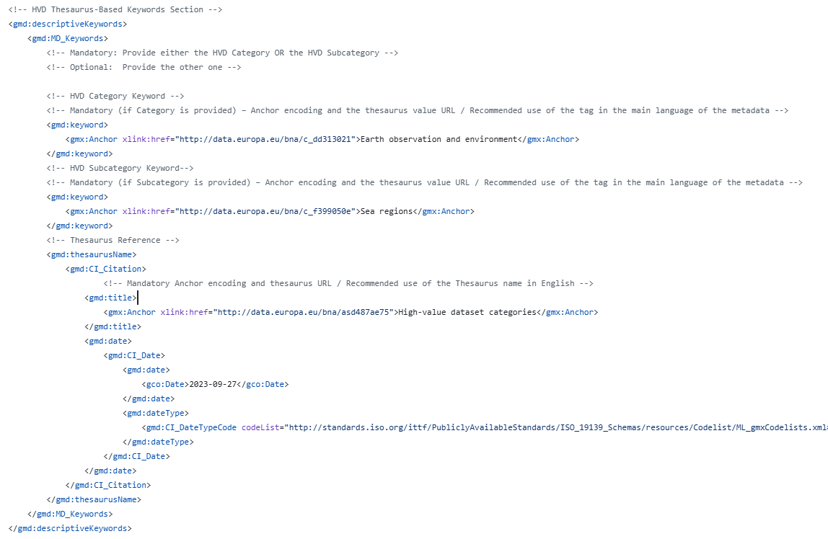
Starting point
Agreed HVD (geospatial) tagging
HVD category
DCAT-AP High Value Datasets
2
Example:
Keyword corresponding to the HVD category (or sub-category)

Slide 4
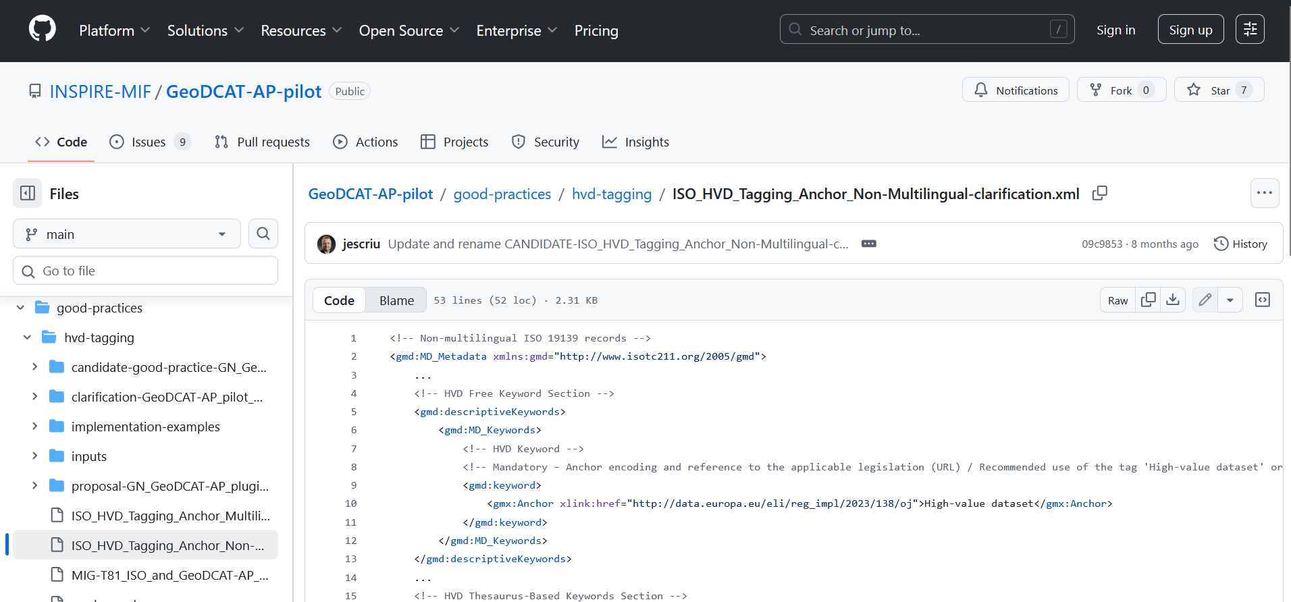
Starting point
Agreed HVD (geospatial) tagging
3
Full details of Phase 1 agreements & implementationexamples:
Available on GitHub
NON- MULTILINGUAL:
https://github.com/INSPIRE-MIF/GeoDCAT-AP-pilot/blob/main/good-practices/hvd-tagging/ISO_HVD_Tagging_Anchor_Non-Multilingual-clarification.xml
MULTILINGUAL:
https://github.com/INSPIRE-MIF/GeoDCAT-AP-pilot/blob/main/good-practices/hvd-tagging/ISO_HVD_Tagging_Anchor_Multilingual-clarification.xml

Slide 5
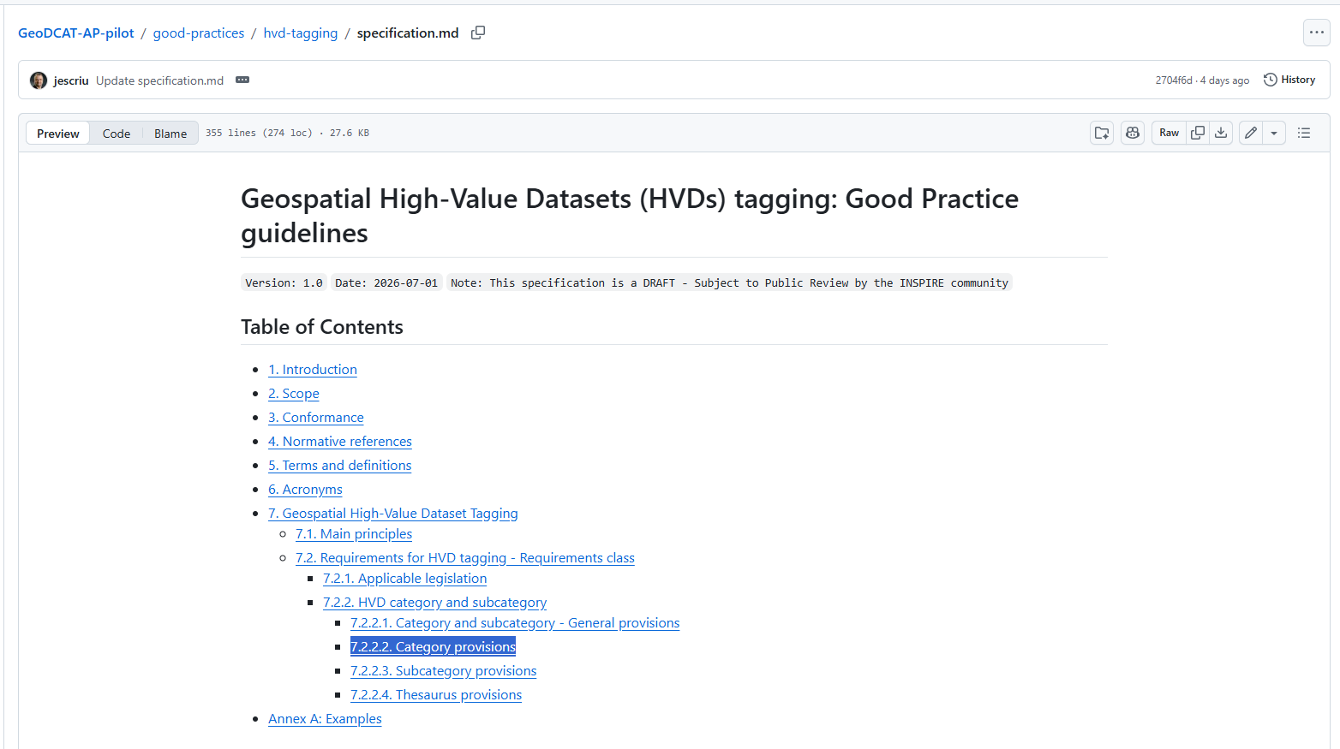
Task
Result
Geospatial High-Value Datasets tagging good practice specification
https://github.com/INSPIRE-MIF/GeoDCAT-AP-pilot/blob/main/good-practices/hvd-tagging/specification.md

Slide 6
Main
principles
ensure that the datasets are denoted as high-value datasets in their metadata description (HVD Regulation, art. 3(5))
Scope
defining the keywords to be used in ISO/INSPIRE metadata records to identify if a dataset is classified as a HVD, meaning that:
the dataset is the scope of the HVD Implementing Regulation;
the dataset belongs to a HVD category and/or subcategory as set out in the Annex to the Implementing Regulation and encoded in the controlled vocabulary.

Slide 7
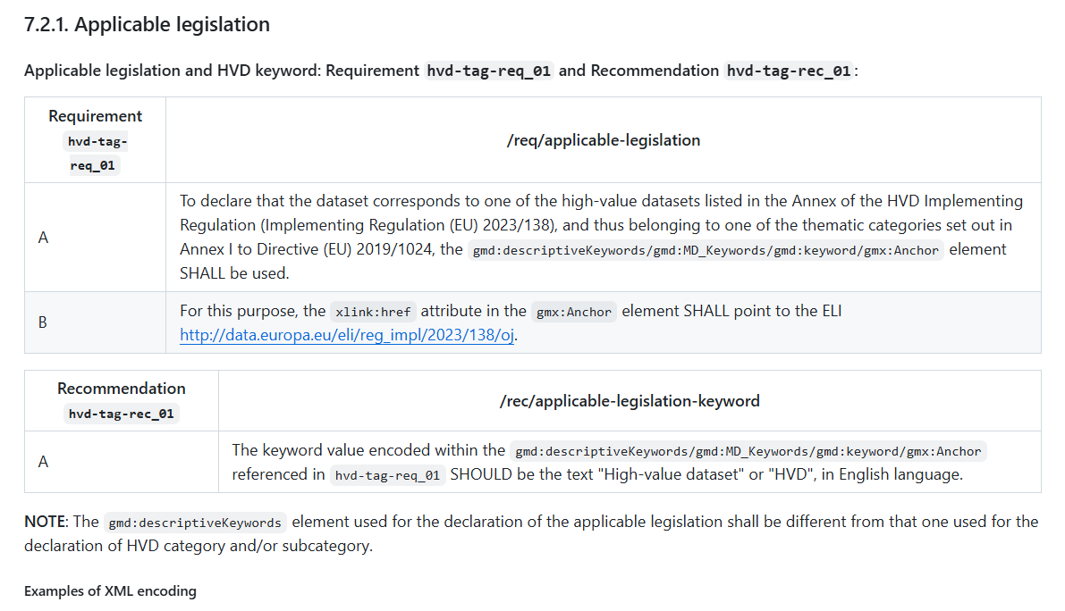
Example of
requirements and recommendations
Requirements and recommendations about:
Applicable legislation
Category and subcategory / General provisions
Category provisions
Subcategory provisions
Thesaurus provisions

Slide 8
Task
Call to contribute
We still need:
implementation evidence
updated examples using the approach agreed for the good practice

Slide 9


Thank you!

